Slide 1
Georgia’s State Plan
Every Student Succeeds Act (ESSA)
Developing a Plan for Georgians, By Georgians

Slide 2
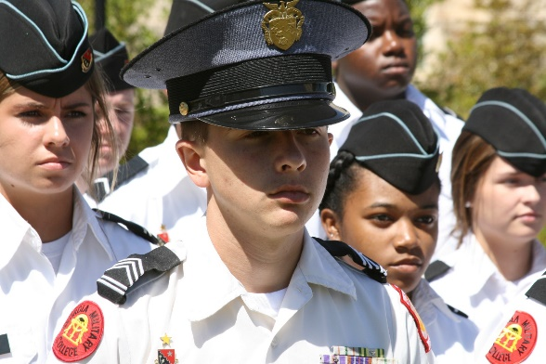
Welcome & Charge
Richard Woods, State School Superintendent

Slide 3
Welcome Richard Woods, State School Superintendent

Slide 4
Charge Richard Woods, State School Superintendent
ESSA is an opportunity for Georgia – Georgians are expecting more from their education system
OUR MISSION
Offering a holistic education to each and every child in the state.
OUR VISION
Educating Georgia’s Future by graduating students who are ready to learn, ready to live, and ready to lead.

Slide 5
Charge Richard Woods, State School Superintendent
DEFINING A NEW READINESS
Early grades: Foundational skills and concepts
Later grades: Multiple paths to succeed by expanding opportunities and personalizing learning
Graduates are college and/or career ready
Life-long Learning

Slide 6
Charge Richard Woods, State School Superintendent
A NEW APPROACH
Connecting the policy dots for our districts
Fostering innovation and expanding flexibility
Growing capacity by supporting our teachers and leaders
Creating a positive learning environment
Providing tools and systems of support

Slide 7
Charge Richard Woods, State School Superintendent
RESPONSIBLE APPROACH TO ACCOUNTABILITY
Since NCLB, our focus has been on creating structures of accountability to measure success
It’s now our responsibility to develop tools and structures of support so districts, teachers, and students can achieve success
Both parts are needed to ensure a world-class education system

Slide 8
Charge Richard Woods, State School Superintendent
A PLAN FOR GEORGIANS, BY GEORGIANS
Stakeholder feedback sessions
State agencies, organizations, nonprofits, stakeholders are at the table

Slide 9
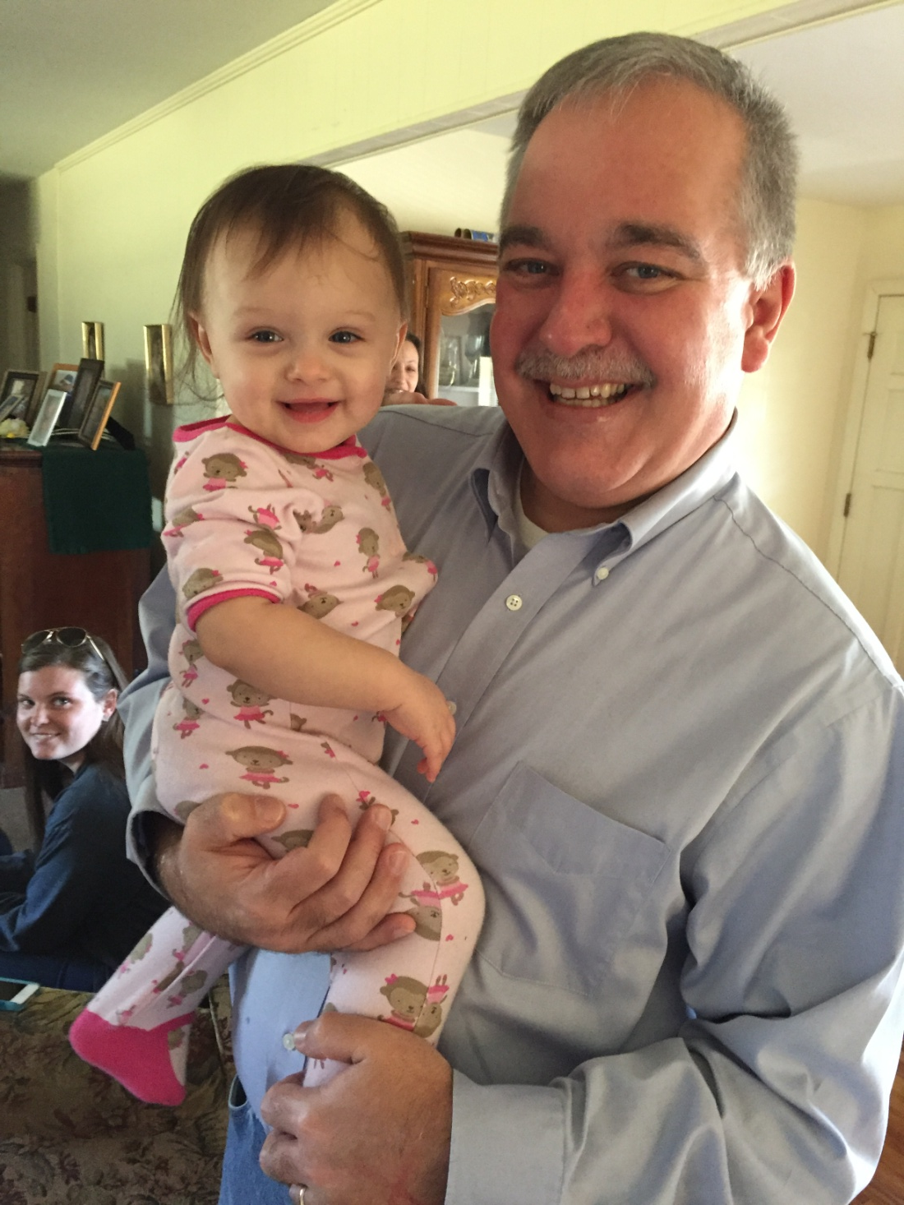

Slide 10
Overview of ESSA
Peter Zamora

Slide 11
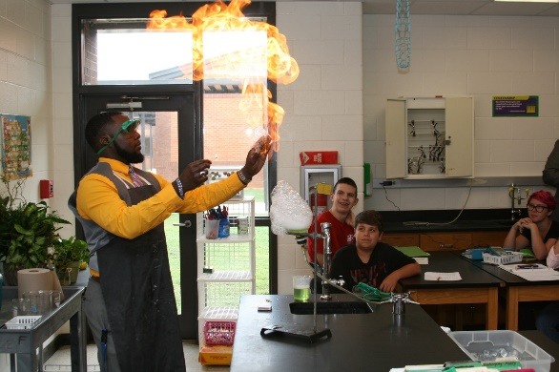
Georgia’s State Plan Development Process
Matt Jones, Chief of Staff

Slide 12
Overall Timeline Georgia’s State Plan Development Process
JULY
Advisory and Working Committees meet
AUG-OCT
Stakeholder feedback sessions
Develop Areas of Focus, Guiding Principles, Framework
OCT-DEC
Draft State Plan
Presentations

Slide 13
Overall Timeline (cont.) Georgia’s State Plan Development Process
JAN
Review period
FEB
Revisions/refinements; Prepare for submission
MAR
Georgia’s ESSA State Plan submitted to USED
Note: Timelines may change based on pending guidance from USED.

Slide 14
State Advisory Committee Timeline Georgia’s State Plan Development Process
JULY
Charge & Orientation
AUG
Develop Areas of Focus and Guiding Principles
Late Sept/Oct
Presentation of stakeholder feedback
DEC
Presentation of draft ESSA State Plan
MAR
Georgia’s ESSA State Plan submitted to USED

Slide 15
State Advisory Committee Georgia’s State Plan Development Process
MAKE UP
40 members
State agencies, organizations, students, parents, teachers, superintendents, advocacy groups
Facilitated by the Carl Vinson Institute

Slide 16
State Advisory Committee Georgia’s State Plan Development Process
CHARGE
Develop Areas of Focus
Guiding Principles
Receive and discuss stakeholder feedback
Review the draft of Georgia’s ESSA State Plan
Provide feedback regarding Georgia’s draft ESSA State Plan

Slide 17
Working Committees Georgia’s State Plan Development Process
MAKE UP
6 working committees
Accountability
Assessment
Federal Programs to Support School Improvement
Education of the Whole Child
Educator & Leader Development
Communications
20 members
5 GaDOE staff; 15 stakeholders

Slide 18
Working Committees Georgia’s State Plan Development Process
SCOPE
Develop feedback questions for stakeholders
Discuss
Stakeholder input
USED’s regulations/guidance
Areas of Focus
Assigned portions of ESSA
Coordinate with other working committees to write Georgia’s draft state plan

Slide 19
Working Committees Georgia’s State Plan Development Process
ACCOUNTABILITY
Report to GaDOE’s ESSA Leadership Team
Meeting benchmarks
Coordinating to produce a cohesive plan
Present to State Advisory Committee for feedback
Review period: Public, State School Superintendent, State Board of Education, and Governor’s Office

Slide 20
Working Committees
Leadership & Scope of Work

Slide 21
Assessment ESSA Working Committee
LEADERSHIP
Melissa Fincher, Deputy Superintendent of Assessment and Accountability
Steve Barker, Superintendent of Coweta Co. Schools
SCOPE
Assessment Alignment, Innovation and Improvement
Title I Part B Assessment Grants

Slide 22
Accountability ESSA Working Committee
LEADERSHIP
Allison Timberlake, Director of Accountability
Molly Howard, Superintendent of Jefferson Co. Schools
SCOPE
Refinement/Enhancements of CCRPI (College and Career Readiness Performance Index) as well as new indicators and subgroup reporting as required by ESSA

Slide 23
Education of the Whole Child ESSA Working Committee
LEADERSHIP
Caitlin Dooley, Deputy Superintendent of Curriculum and Instruction
Susan Adams, Assistant Commissioner for Pre-K & Instructional Support for DECAL
SCOPE
Title IV Part A Student Support and Academic Enrichment (SSAE) Grants
Title IV Part F National Activities
Title IX Preschool Development Grants
Literacy Education for All, Results for the Nation (LEARN) Act

Slide 24
Communications ESSA Working Committee
LEADERSHIP
Matt Cardoza, Chief Communications Officer
Stan DeJarnett, Executive Director of the Georgia Vision Project
SCOPE
Develop a framework for the stakeholder feedback sessions
Coordinate with other working committees to develop effective methods for soliciting stakeholder feedback
Engage communities and stakeholders to attend feedback sessions
Utilize the networks of education partners to promote feedback sessions and elements of Georgia’s state plan
Develop a comprehensive plan/strategy for communicating Georgia’s state plan

Slide 25
Federal Programs to Support School Improvement ESSA Working Committee
LEADERSHIP
Debbie Gay, Director of Special Education
Leigh Ann Putman, Metro RESA

Slide 26
Federal Programs to Support School Improvement (cont.) ESSA Working Committee
SCOPE
Title I
Part A
Part C Migratory Children
Part D Children and Youth who are neglected, delinquent or at-risk
Part E Consolidation of funds
Title III English Language Learners and Immigrant Students
Title IV 21st Century Schools
Part B 21st Century Learning Centers
Part C Charter School Grants
Title VIII Homeless
Criteria, support, and processes for Comprehensive Support and Improvement Schools
Criteria, support, and processes for Targeted Support and Improvement Schools

Slide 27
Educator & Leader Development ESSA Working Committee
LEADERSHIP
Cindy Saxon, Associate Superintendent of Teacher and Leader Effectiveness
Ernie Lee, former Georgia Teacher of the Year
SCOPE
Teacher and School Leader Incentive Fund
Educator Equity Plan
Develop a system of supports for the teacher and leader continuum (from prep and induction through leadership opportunities)
Title II
Educator Development Academies

Slide 28
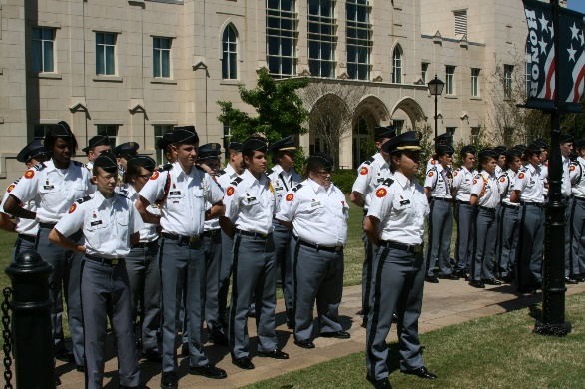
Ticket Out the Door
Stacy Jones, Carl Vinson Institute

